Slide 1
Learning as a Service: A Growth Multiplier
An Embedded Learning Partner — Enabling Readiness That Scales
November 2025
Notes:
GCCs are a growing industry
ANSR is a market leader in the GCC domain
Common challenges by GCCS
What is the long term, sustainable solution?
What are our offers?
What do they cost?

Slide 2
Individual Contributor Courses

Slide 3




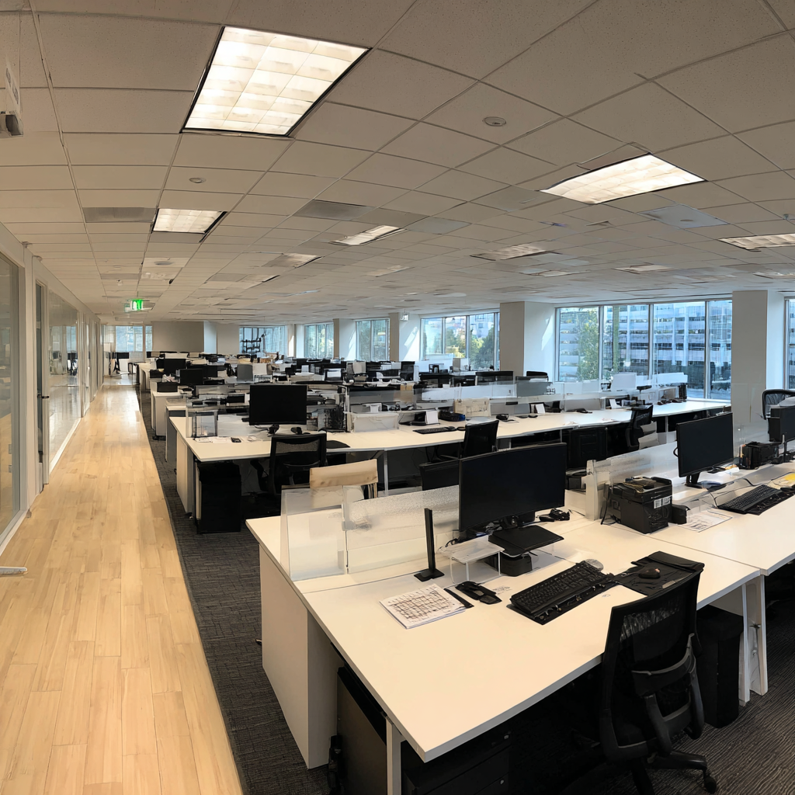


Day 1 Onboarding Delivery for GCCs
Consistent. Confident. Ready from Day One.
Pre-Day 1 Prep
Access, assets
Operational Readiness
Day 1 Welcome
Greetings
Tech & Access
Laptop, login, badge
Company Info
Purpose, values, ways of working
Cultural Readiness
First Day Confidence Check
Pulse check
We deliver Day 1 so your teams can focus on Day 2 and beyond

Slide 4

The 30-60-90 Structure
Day 2–30
Day 31–60
Day 61–90
Onboard & Understand
Contribute & Apply
Own & Impact
Access ▸ Context ▸ Product ▸ Process ▸ Policies ▸ Confidence
Execution ▸ Collaboration ▸ Autonomy ▸ AI Productivity
Independence ▸ Accountability ▸ Innovation ▸ Influence

Slide 5
Critical Thinking
Building Sharper Judgment, Stronger Decisions, and Leadership Maturity
Self-Awareness & Cognitive Bias
Critical Thinking Foundations
Contextual Thinking
Understanding common biases and their impact on leadership decisions through interactive case simulations and real-world scenarios
Applying the RED Model (Recognize–Evaluate–Draw Conclusions) to improve judgment clarity and decision-making accuracy
Using systems thinking and stakeholder mapping to identify interdependencies and anticipate downstream organizational impact
Engage with real leadership scenarios
Analyze decisions and outcomes
Structured Decision-Making
Enhanced Coordination
More consistent and repeatable processes for complex business challenges
Better cross-functional collaboration and faster problem resolution across teams
Experience
Reflect
Implement new approaches immediately
Build frameworks for understanding
Apply
Concept-ualize
Reduced Errors
Leadership Maturity
Fewer mistakes caused by cognitive bias or misalignment with stakeholder needs
Increased confidence and stronger alignment to global expectations

Slide 6
Navigating the Matrix
Accelerating Decision-Making in a Global Matrix
GCCs require cross-functional collaboration
Practical skills for success
Designed for your reality
Decode decision pathways
Build stakeholder alignment
Escalate intelligently
Navigate trade offs confidently
GCC specific scenarios
Actionable frameworks
Global workflows aligned
Immediate application
Clarity on decision making
Prioritization
Alignment
Your Learning Journey
Week 1
Week 3
Week 5
Understand the Matrix
Influence and Alignment
High Stakes Scenarios
Map stakeholders
Decode structures
Identify decision-blockers
Navigate ambiguity with confidence and structure
Build credibility
Manage conflicts
Align without authority
Earn trust, build alignment, drive outcomes
Smart escalation
Negotiate timelines
Drive decisions
See the whole picture, manage dependencies

Slide 7
Decoding the Business: A Practical Guide for GCC Talent
Hybrid Learning Format
Optional Enhancement
Flexible program designed for GCC-based professionals seeking stronger business acumen
Interactive sessions with real-world application
Case studies from shared services environments
Practical tools for immediate use
Business Acumen Simulation
Run a virtual company, make strategic choices, watch financial outcomes unfold
3
Comprehensive Modules
100%
Practical Application
1
Optional Simulation
Core Program Modules
1
How the Business Works
2
Finance for Non-Finance Roles
3
Market Awareness + Marketing Essentials
Value chain fundamentals
Buasiness models
Customer & stakeholder ecosystems
Revenue, cost, and margin
Financial KPIs that drive decisions
Value creation vs. value destruction
Industry trends and disruption patterns
Competitor and market analysis
Translating insights into smarter execution
Understand how the business makes money. Connect your work to what matters. Make decisions that drive value

Slide 8
Manager Courses

Slide 9






ASCEND: Leadership Alignment Program
A Half-Day Framework for New Managers
ASCEND is a structured leadership alignment program designed to help new managers stabilize teams, integrate global operations, and accelerate performance. This framework guides leaders through six critical phases Align, Strategize, Cultivate, Engage, Nurture, and Drive with each supporting your team's journey from formation to high performance
Align
Strategize
Understand enterprise goals and GCC charter. Clarify team roles and success metrics. Guide your team through Forming: establish purpose and ways of working
Set 30/60/90-day priorities for operational readiness. Build repeatable processes. Support your team in Storming: normalize conflict and address friction early
Cultivate
Engage
Shape a trusting, psychologically safe environment. Model communication norms and accountability. Enable your team to move into Norming: embed rituals and create consistency
Build strong relationships with HQ and global partners. Communicate progress effectively. Reinforce cross-functional collaboration and shared ownership across teams
Nurture
Drive
Develop capability through upskilling and coaching. Give clear performance feedback. Identify early talent and promote peer learning throughout the organization
Lead performance rhythms that enable predictable outcomes. Use data and continuous improvement. Guide your team into Performing: high ownership and consistent delivery
This framework aligns with Tuckman's stages of team development, providing practical tools to navigate each phase. By following ASCEND, you'll build high-performing teams ready to deliver excellence in the GCC India environment

Slide 10
Guiding Performance
Practical GROW Coaching for GCC Leaders
Build muscle memory in structured coaching conversations that drive real accountability and results
Full-Day Workshop
Triad Practice
Lasting Skills
In-person, hands-on practice with real scenarios from your environment
Structured peer coaching with immediate feedback loops
Confidence and consistency in every 1:1 and performance conversation
70%
85%
90%
Fewer Escalations
Stronger Ownership
Manager Confidence
Clearer Conversations
Faster Resolution
Coaching Confidence
Structured approach replaces rambling discussions
Issues addressed quickly with direct coaching
Managers who lead conversations with skill and consistency
"This isn't theory. It's practical coaching you'll use the very next day and every day after."

Slide 11
Delegation & Stakeholder Alignment
This program is about decision rights, influence without authority, and operating effectively in global matrices where power, accountability, and execution are distributed.
1
2
3
Delegation Across Distance, Culture, and Power
Decision Rights in Matrixed, Global Organizations
Stakeholder mapping across Global Systems
Executives must learn to:
Delegate outcomes rather than activities across time zones and cultures
Calibrate delegation based on capability, trust, and local context
Establish clarity on what must be standardized vs. locally owned
Clarifying who decides, who influences, and who executes
Navigating competing priorities across units
Preventing decision paralysis in multi-stakeholder environments
Managing escalation without undermining local leaders
Identify formal vs informal power holders across regions
Read economical and cultural dynamics to avoid negative repercussions on the organization
Build credibility quickly with unfamiliar stakeholders
Manage legacy relationships
4
5
Influence without Authority
Trust, Visibility, and Accountability at Scale
Critical global skills:
Leading when authority is indirect or shared
Adapting influence style by culture and context
Using enterprise narrative rather than positional power
Managing resistance without damaging long term relationships
Executives practice:
Creating predictable leadership presence without micromanaging
Setting clear accountability across distributed teams
Maintaining visibility without exhausting the organization
Knowing when to step in and when not to

Slide 12
ASCEND+ Advanced Manager Program
Why you need this course
Operational Excellence
Data-driven decision making
Risk visibility and mitigation
Transform experienced frontline managers into influential leaders who drive cross-functional outcomes and support the GCC's strategic growth
Systems Thinking
Building scalable systems
Redesigning approaches through experimentation
Strategic Thinking
How managers experience it
Prioritization
Linking work to enterprise goals
6–8 interactive modules with live practice labs, real GCC scenarios, and a culminating capstone business challenge
Stakeholder Influence
Executive communication
Global alignment
What managers leave with
Team Development
Managers leave with clarity, the ability to influence outcomes, and ownership of results. They are equipped to lead at scale as the GCC matures
Building capability pipelines / succession planning
Accountability Frameworks
Cross-functional Impact
Managing dependencies
Building collaborative partnerships

Slide 13




Conflict & Performance Conversations
Leaders must deliver results while fostering psychological safety. Lead with Courage is a high-impact hybrid program for experienced leaders who struggle with the balance between empathy and accountability
Hold Accountable
Build Safety
Hold others accountable without creating fear or mistrust
Build psychologically safe teams that perform at their best
Gain Alignment
Navigate Tension
Use negotiation and influence to gain alignment toward target achievement
Navigate tension and resistance with confidence
Lead with Courage is a leadership transformation experience that equips leaders to unlock discretionary effort and drive sustainable performance through a balanced approach of empathy and accountability. Grounded in the proven techniques of Chris Voss (negotiation), George Kohlrieser (emotional bonding), and Marshall Goldsmith (leadership behavior change)
Driving Results with Empathy

Slide 14
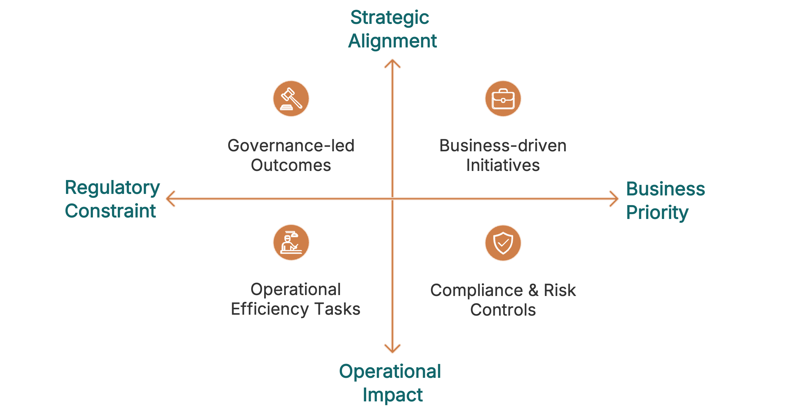
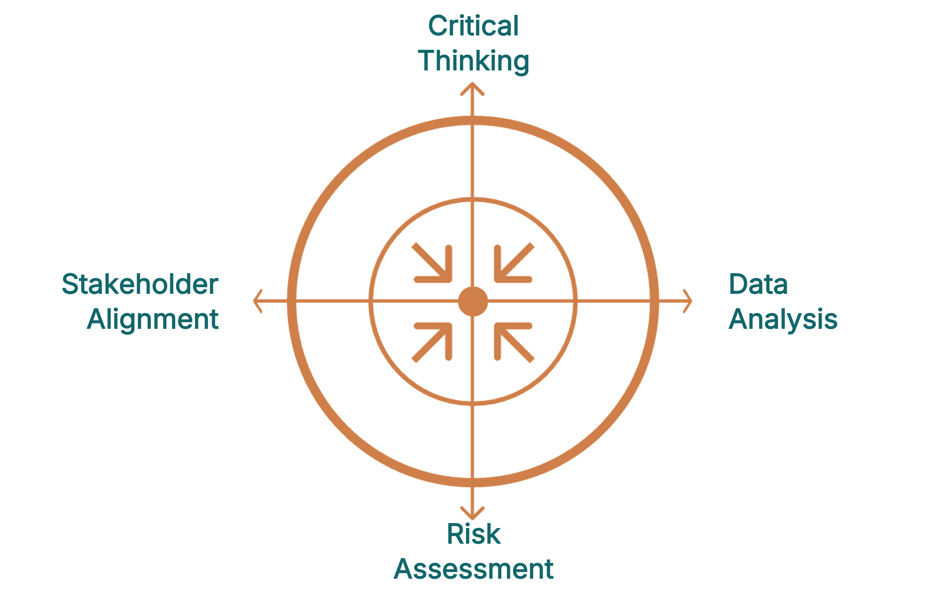
People Leader Academy (pipeline to director)
Systems Thinking
Leadership Labs
Ready-Now Pipeline
Enterprise-level strategic perspective
Scenario practice & real cases
Unified leadership language

Slide 15
Coaching Next Line Leaders
Transform your leaders from performance managers into people developers who are creating a sustainable talent pipeline that drives retention, succession, and long-term growth.
Why It Matters
What We're Building
How It Works
Growth demands leadership evolution. As organizations scale, traditional management falls short causing retention risks to spike and succession gaps to widen without intentional people development.
Modern talent development approach. Moving beyond GROW coaching to practical frameworks that identify strengths, create meaningful stretch opportunities, and build leadership bench strength.
Embedded, practical application. Live practice sessions, readiness assessments, and calibrated challenges integrated into existing workflows.
3x
70%
15min
Retention Impact
Leadership Gap
Weekly Investment
Organizations with strong coaching cultures see 3x higher retention of high performers
Of companies report insufficient leadership bench strength for future needs
Regular coaching integrated into existing 1-on-1 rhythms
When leaders coach for development, performance becomes a natural byproduct of engaged, growing teams.

Slide 16
Leading Change at Scale
A proven, three-phase approach designed for high-complexity operational environments where culture must translate directly into employee and customer experience
Phase 1
Phase 2
Phase 3
Unlearn
Translate
Amplify
Replace outdated norms with current vision
Build psychological safety for change
Create space for new behaviors to emerge
Co-create observable micro-behaviors
Enable leaders to model authentically
Connect values to real operations
Build cross-functional ambassador network
Equip champions with influence tools
Create peer to peer reinforcement
This framework blends proven methodologies—ADKAR, Kotter, and our proprietary micro-behavior modeling—specifically adapted for environments where operational excellence and culture are inseparable

Slide 17
Executive Courses

Slide 18
One Voice, One Message, One Direction
Executive alignment for unified leadership action
Align leaders on priorities, expected behaviors, and communication norms so the entire organization moves in the same direction with clarity and confidence
Leaders will gain a unified leadership narrative that helps them deliver consistent messaging and clear priorities to the organization
By following a clear structure, leaders will identify shared priorities, define their leadership identity, and commit to a course of action
Tangible takeaways will include their leadership messaging, success measures, priority focus areas, quick wins, and individual commitments

Slide 19

Enterprise Thinking and Ownership
Enterprise Thinking
Strategic Alignment
Risk Escalation Scenarios
Executive Presence

Slide 20



Building a high-performance culture
As global capability centers scale, traditional performance management approaches fall short. Growth demands a fundamental shift from heroics and escalation to systematic, manager-led accountability. This framework equips senior leaders to embed high-performance behaviors that scale across enterprise operations.
The Scaling Challenge
Manager Ownership
Cultural Alignment
Rapid growth exposes gaps in performance systems. Ad hoc escalations and firefighting become unsustainable as teams expand across locations and functions.
Leaders must transition from operational oversight to enterprise stewardship. Managers need capability and authority to resolve issues at the source, not dependency on escalation.
GCC performance standards must mirror HQ expectations. Clear non-negotiables and data-driven decision frameworks create consistency across geographies.
Diagnose Barriers
Build Accountability
Use performance data to identify systemic bottlenecks. Move beyond anecdotal evidence to understand root causes: skill gaps, unclear expectations, or structural impediments.
Equip leaders with GCC-specific tools and scenarios. Develop capabilities to coach, intervene, and reinforce standards through consistent, repeatable processes.

Slide 21
Change Leadership & Transformation
Building Transformation that Sticks
The Shift Required
The business problem: Legacy ways of working block next-phase growth
The core insight: Misalignment drains momentum.
From executing plans to reshaping execution
From announcing change to embodying change
From managing activities to owning outcomes
Director-Level Change Leadership in Practice
1
2
3
Redesign Workflows
Model the Behaviors
Build Momentum
Reshape decision flows and operating rhythms—not just messaging. Change how work gets done.
Demonstrate the transformation you're asking for. Leaders go first, visibly and consistently.
Create visible wins. Accelerate adoption through strategic leadership actions that compound.
4
5
Create Behavioral Clarity
Align Systems
Define expectations precisely. Align teams and functions around shared behaviors and outcomes.
Redesign incentives, metrics, and operating cadences to reinforce the transformation.
This is not about managing change.
It is about leading the enterprise differently with purpose, precision, and the behaviors that make transformation stick.

Slide 22

Leadership Coaching for Cross-border Impact
High-stakes 1:1 executive coaching
Personalized focus on presence, communication, and organizational politics
Approach
Scenario-based coaching and data-driven reflection
Practice strategic updates and risk escalations
Translate operational excellence into strategic impact
Outcome
Confident global leaders with HQ influence

Slide 23
Enterprise Mindset & Business Strategy
This course builds an enterprise mindset that enables Directors to move beyond execution and alignment, developing the strategic, commercial, and analytical capabilities required to actively shape global strategy and operate as true business partners to HQ.
From Alignment to Enterprise Ownership
Shift Directors from strategy recipients to co-architects who shape direction based on enterprise needs.
Connecting GCC Value to Global Priorities
Translate GCC strengths into measurable strategic advantage across regions and functions.
Strategic Insight from Enterprise Data
Generate forward-looking insights that inform decisions, not just report performance.
Scenario Thinking and Trade-Off Navigation
Build and evaluate strategic options across markets, risks, and resource constraints.
Commercial Acumen and Strategic Language
Expand financial, strategic, and commercial fluency to engage credibly with global executives.

Slide 24
Global Mobility Readiness
This program prepares executives to step into global roles with confidence by scaling their leadership identity across cultures, systems, and markets while navigating the real operational and personal demands of international deployment.
Executive presence and matrix leadership
Cultural agility
Transition planning
Resilience
Coaching
Leadership identity

Slide 25






SUMMIT: Building a Growth and Innovation Mindset
Capstone for Executive Leaders
SUMMIT is a capstone experience for executive leaders who recognize that growth and innovation are leadership obligations. It reshapes how leaders think, decide, and act so innovation becomes a repeatable enterprise capability, not a one-off initiative.
Growth and innovation as leadership capability
Innovation labs and experimentation frameworks
Understand enterprise goals and GCC charter. Clarify team roles and success metrics. Guide your team through Forming: establish purpose and ways of working
Set 30/60/90-day priorities for operational readiness. Build repeatable processes. Support your team in Storming: normalize conflict and address friction early
Identify opportunities in data and market signals
Curiosity, risk-taking, psychological safety
Shape a trusting, psychologically safe environment. Model communication norms and accountability. Enable your team to move into Norming: embed rituals and create consistency
Build strong relationships with HQ and global partners. Communicate progress effectively. Reinforce cross-functional collaboration and shared ownership across teams
Anticipate disruption; internally and externally
Daily growth habits and coaching integration
Develop capability through upskilling and coaching. Give clear performance feedback. Identify early talent and promote peer learning throughout the organization
Lead performance rhythms that enable predictable outcomes. Use data and continuous improvement. Guide your team into Performing: high ownership and consistent delivery
Outcome: GCC leaders as architects of future growth

Slide 26
Miscellaneous

Slide 27




Global Perspectives
First 30 Days Cross-Cultural Communication Onboarding
The Challenge
The Solution
The Outcome
Same language, different meanings. High-context vs. low-context styles collide and cause miscommunication and rework
Equip new hires with foundational skills to communicate clearly, respectfully, and confidently across cultures
Shared norms, stronger trust, faster collaboration to equip teams to perform seamlessly across borders
Week 1
Week 2
Week 3
Week 4
Foundations
Operational Impact
Relationships & Safety
Application & Habits
Understand how culture affects communication approaches and identify personal styles
Learn standardized norms and practice writing for global clarity
Build trust through respectful feedback and shared mental models
Adopt team norms, shared vocabulary, and sustained collaboration practices
Cultural Awareness
Shared Vocabulary
Recognize high-context vs. low-context styles and how assumptions create friction in global teams
Establish common definitions for key terms to eliminate false clarity
Clear Communication
Psychological Safety
Practice writing and speaking with precision to reduce ambiguity in emails, meetings, and updates
Build trust across cultures through respectful feedback, alignment checks, and shared norms
"By the end of the first month, our employees understood how culture affects communication, what expectations were from HQ, where typical misunderstandings arise, and how to collaborate to deliver high performance”
– GCC Site Head
Notes:
oo

Slide 28
Case Studies

Slide 29
Critical Thinking
Building Decision-Making, Ownership, and Enterprise Confidence in a GCC
Business challenge
Intervention
Business impact
Before
After
❐
Delivered as a layered GCC leadership capability journey
Embedded critical thinking and decision frameworks to improve judgment quality
Built delegation with clear decision rights to reduce dependency and bottlenecks
Strengthened stakeholder communication and business storytelling
Reinforced ownership through manager-as-coach behaviors and real-work simulations
Business acumen & fluency
26%
55%
+30
Points
Highly capable technical teams, but limited business judgment and ownership
Decision speed (idea → pilot)
7.4 months
4.8 months
33%
faster
Managers escalated decisions upward, slowing execution and eroding HQ confidence
Business storytelling effectiveness
11%
29%
2.5×
Leader coaching behaviors
58%
87%
+29
points
Strong execution culture, but low innovation, weak stakeholder storytelling, and delayed decision cycles
Execution-only mindset
42%
19%
55%
When leadership capability is built intentionally and embedded into daily work, a GCC can move from execution support to enterprise partnership earning trust, autonomy, and strategic influence.

Slide 30
Accelerating Time to Productivity
Scaling a GCC Through Structured Functional Onboarding
Business challenge
Intervention
Business impact
Structured, role-specific onboarding journeys tied to real work
Clear product, process, and support-pathway visibility
Standardized onboarding experience across teams and managers
Time to productivity reduced by 35%
Rapid GCC scale-out created long ramp-up times for mid-career hires
New hires reached benchmarks in 45 – 60 days
New employees lacked clarity on products, processes, and escalation paths
Early project cycle rework reduced by 40%
Delayed productivity threatened delivery timelines and margin targets
Employee and manager satisfaction improved measurably
When onboarding is treated as a business acceleration lever, GCCs scale faster, reduce delivery risk, and protect profitability.

Slide 31
Turning Digital Investment into Frontline Execution
Using GranuLearn® to Build Last-Mile Adoption at Scale
Business challenge
Intervention
Business impact
Positioned GranuLearn® as a frontline capability engine, not a content platform:
Centralized, mobile-first LXP for sales and field roles
Role-specific, task-aligned learning pathways tied to real workflows
In-flow nudges integrated into CRM and field systems
Pilot → industrialize → scale model led by the GCC
25–30% reduction in manual errors within 6 months
Rapid GCC scale-out created long ramp-up times for mid-career hires
40% improvement in adoption of core digital workflows
Manual workarounds persisted across sales, service, and field supervision
35% faster decision cycles through improved data usage
30–40% improvement in frontline time-to-productivity
Managers lacked real-time visibility due to incomplete or delayed data
10–18% increase in conversion ratios in key markets
GranuLearn® enables GCCs to convert digital tools into consistent frontline execution, faster decisions, and measurable commercial impact.

Slide 32
Functional Onboarding
Accelerating Time to Productivity
Business challenge
Intervention
Business impact
Implemented a simple, repeatable functional onboarding model owned by the GCC
Role-specific onboarding journeys tied directly to real work
Clear visibility into products, processes, and support mechanisms
Consistent onboarding experience across teams and managers
35% reduction in time to productivity
Rapid hiring created long ramp-up times for experienced hires
New hires reached benchmarks within 45 – 60 days
New employees lacked clarity on products, processes, and escalation paths
40% reduction in early-cycle project rework
Managers spent excessive time correcting early mistakes instead of delivering
Improved manager confidence and employee satisfaction
For mid-market GCCs, structured functional onboarding is one of the fastest, lowest-risk ways to scale delivery capacity while protecting margins.

Slide 33
Change Management
Driving Behavior Change at Scale
Business challenge
Intervention
Business impact
Defined clear behavior shifts tied to strategic priorities
Multi-level change journey: leaders, managers, and teams
Reinforcement through real-work application, nudges, and sponsor visibility
Change embedded into workflows
Consistent adoption of new behaviors across functions
Multiple transformation initiatives underway, but behaviors were not changing
Reduced resistance and faster transition to new ways of working
Leaders interpreted “change” differently, creating confusion and resistance
Improved execution reliability during transformation phases
Old ways of working resurfaced after launch phases
Leaders equipped to lead and sustain change locally
Change succeeds when behaviors are intentionally designed, expectations are set and reinforced, and outcomes are measured consistently.

Slide 34
Culture
Turning Values into Daily Behaviors
Business challenge
Intervention
Business impact
Leadership Activation Labs translating values into observable behaviors
Values-in-process workshops to remove process – culture misalignment
Micro-behaviors, huddle guides, and role-specific playbooks
Values embedded into promotion, performance, and vendor criteria
Leaders consistently role-model expected behaviors
Values were well known but not consistently lived
Clear behavioral standards across teams and geographies
Teams interpreted “the same values” differently across functions
Faster escalation, better cross-functional collaboration
Leaders hesitated to call out misaligned behaviors, slowing decisions
Values shift from “posters” to operating norms
Culture scales only when behaviors are defined, reinforced, and hard-wired into how work gets done.

Slide 35
Lead with Intent
Enabling New Managers to Shift from Doing to Leading
Business challenge
Intervention
Business impact
Experiential simulations focused on real leadership moments
Reflection, peer coaching, and manager-as-coach reinforcement
Clear leadership shifts: task → outcome, compliance → commitment
86% report higher confidence in people decisions
High performers promoted into manager roles without leadership readiness
Manager effectiveness scores ↑ 22%
New managers over-relied on escalation and senior direction
Engagement and psychological safety ↑ significantly
Communication and accountability broke down during rapid scale
Leadership behaviors sustained beyond 180 days
Intentional behavior change is required to build a leadership pipeline.

Slide 36
Storytelling
Signal Shift: Building communication and storytelling as a capability
Business challenge
Intervention
Business impact
Structured communication and clarity frameworks
Data-to-storytelling capability for analysts and managers
Leadership reinforcement for feedback, alignment, and decision framing
Rework ↓ 32%
Strong technical work, but unclear, misaligned communication
Project cycle times ↓ 28%
Data-heavy updates slowed decisions and increased rework
Decision cycles ↓ 30%
Managers struggled to influence across a growing matrix
Turnover ↓ 18% in high-pressure roles
When communication becomes a capability rather than a soft skill, execution speed and trust increase.

